Slide 1
Decision Tree Method-WORKSHOP ML ALGORITHM

Slide 2
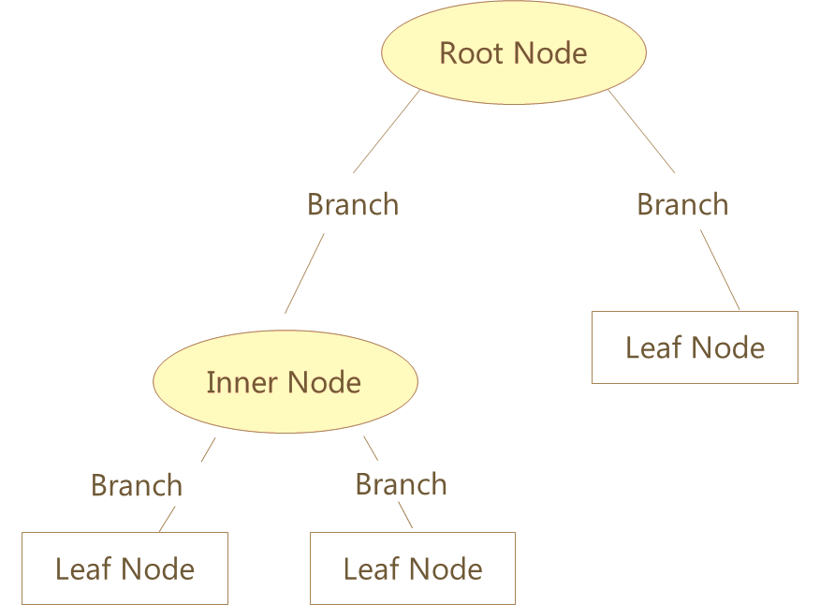
Decision Tree – Basic Components
The first variable used for separating the observations
Categories of Attribute
Next attribute for separating the observations
Class Labels
*
Class labels show observations belong to which class. The leaf node also shows Number of observations and Error rate (Actual classification vs classification given by the tree)

Slide 3
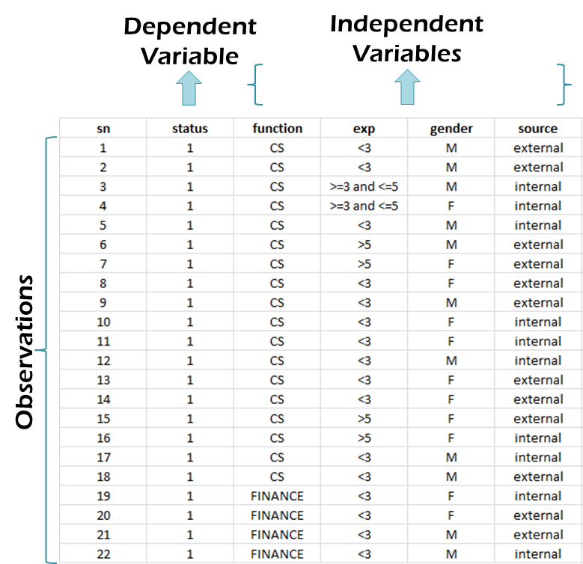
Data Snapshot
EMPLOYEE CHURN DATA
Columns | Description | Type | Measurement | Possible values
sn | Serial Number | - | - | -
status | = 1 If the Employee Left Within 18 Months of Joining = 0 Otherwise | Binary | 1,0 | 2
function | Employee Job Profile | Categorical | CS, FINANCE, MARKETING | 3
exp | Experience in Years | Categorical | <3,3-5,>5 | 3
gender | Gender of the Employee | Categorical | M,F | 2
source | Whether the Employee was Appointed via Internal or External Links | categorical | external, internal | 2

Slide 4
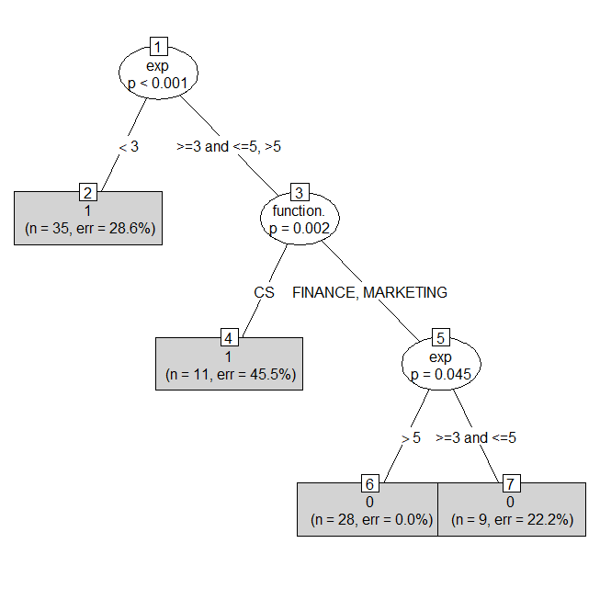
Decision Tree in R…. CHAID-like Implementation in "partykit"
empdata<-read.csv(file.choose(),heade=T,stringsAsFactors =T)
install.packages("partykit")
library(partykit)
empdata$status<-as.factor(empdata$status) # classification problem
ctree<-partykit::ctree(formula=status~function.+exp+gender+source,
data=empdata)
plot(ctree,type="simple")
_________________________________________________________________
35 employees with
exp<3.
Out of which 25
have Y=1 and 10 have Y=0
25/35=0.714

Slide 5
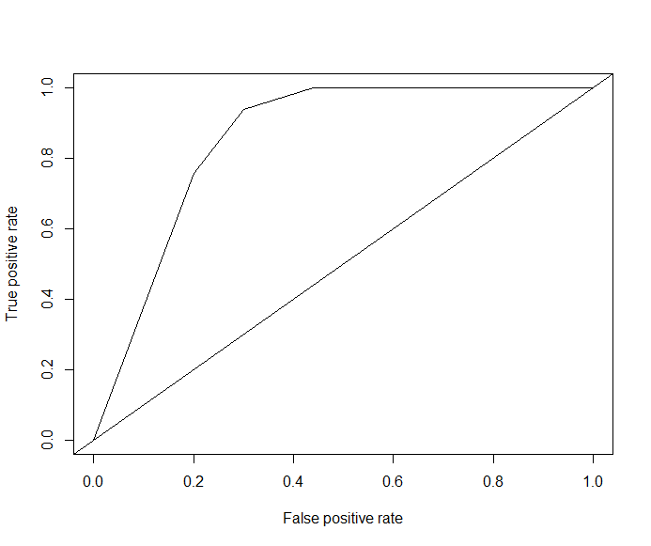
Decision Tree in R…. ROC Curve for "partykit" tree
predtree<-predict(ctree,empdata,type="prob")
library(ROCR)
pred<-prediction(predtree[,2],empdata$status)
perf<-performance(pred,"tpr","fpr")
plot(perf)
abline(0,1)
## Area under ROC Curve in R (AUC)
auc<-performance(pred,"auc")
auc@y.values
__________________________________________________________________
[[1]]
[1] 0.8563636

Slide 6
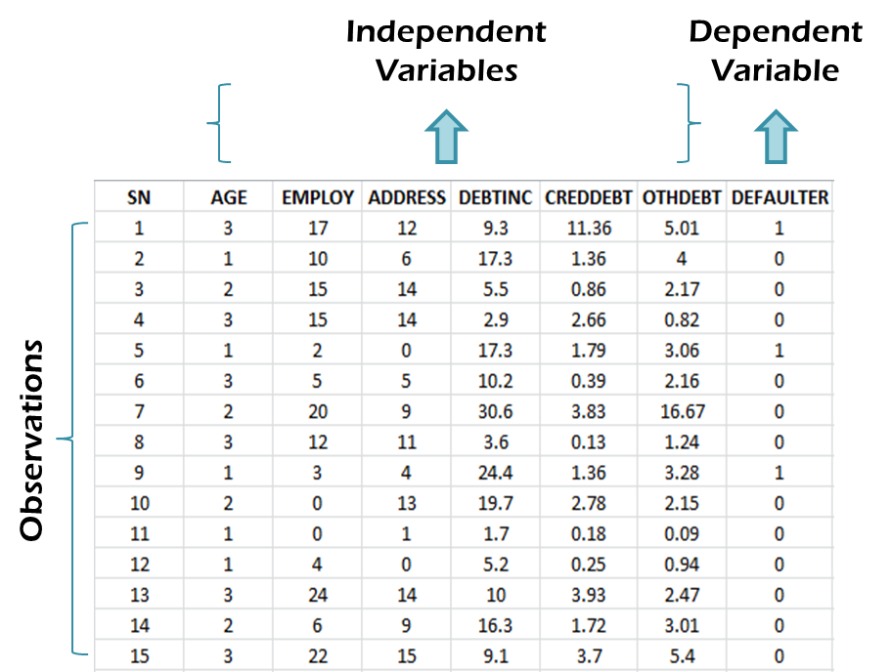
BANK LOAN:Data Snapshot
BANK LOAN
Column | Description | Type | Measurement | Possible Values
SN | Serial Number |  | - | -
AGE | Age Groups | Categorical | 1(<28 years),2(28-40 years),3(>40 years) | 3
EMPLOY | Number of years customer working at current employer | Continuous | - | Positive value
ADDRESS | Number of years customer staying at current address | Continuous | - | Positive value
DEBTINC | Debt to Income Ratio | Continuous | - | Positive value
CREDDEBT | Credit to Debit Ratio | Continuous | - | Positive value
OTHDEBT | Other Debt | Continuous | - | Positive value
DEFAULTER | Whether customer defaulted on loan | Binary | 1(Defaulter), 0(Non-Defaulter) | 2

Slide 7
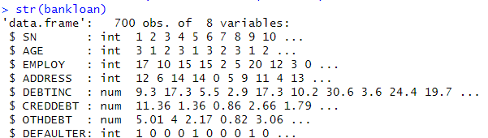
Decision Tree for Continuous & Categorical Independent Variables
# ctree() for Continuous Independent Variables
bankloan<-read.csv("BANK LOAN.csv",header=T) str(bankloan)
str() is used to check the structure of all variables.
We convert DEFAULTER and AGE to factor variables using as.factor() as in our data these 2 variables are categorical.
# Output
bankloan$AGE<-as.factor(bankloan$AGE) bankloan$DEFAULTER<-as.factor(bankloan$DEFAULTER) bankctree<-partykit::ctree(DEFAULTER~AGE+EMPLOY+ADDRESS+DEBTINC+ CREDDEBT+OTHDEBT, data=bankloan)

Slide 8
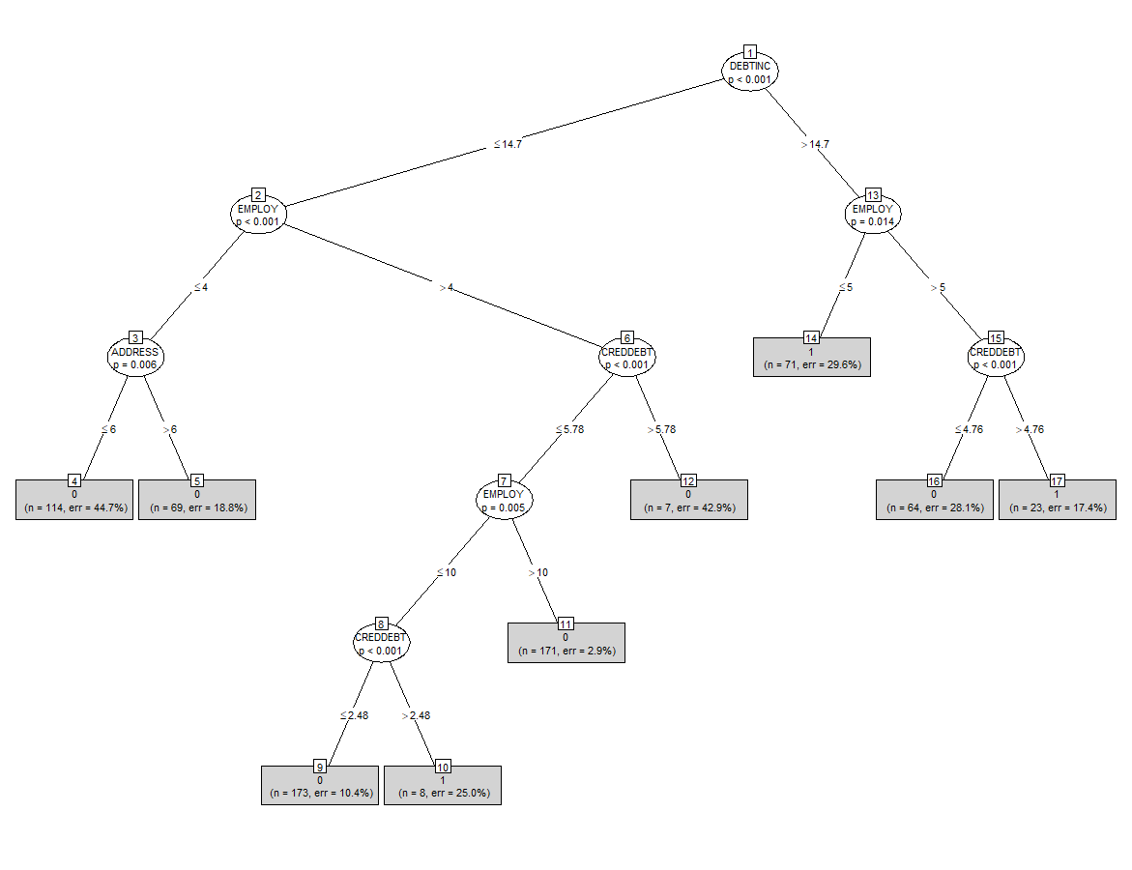
Decision Tree for Continuous & Categorical Independent Variables
1: Defaulter
0: non-defaulter
plot(bankctree,type="simple", gp=gpar(cex=0.7))

Slide 9
Note
The “gp” argument is used to specify graphical parameters for customizing the appearance of the plot.
These settings can control various aspects of the graphical output, such as colors, line types, line widths, font sizes, etc.
For the “cex” parameter specifically, it controls the magnification of text and symbol sizes relative to the default size. The range for cex typically goes from 0 (which would effectively make text and symbols invisible) to any positive value greater than 0, where higher values increase the size of text and symbols.

Slide 10
Interpretation
DEBTINC is the root node.
This is a continuous variable. Ctree algorithm has automatically converted it into a categorical variable with 2 categories <=14.7 and >14.7.
Customers with < 14.7 DEBTINC, and the number of years at the current employer are <=4, then
a) if the number of years at the current address are <=6, there are 114 such customers.
These customers are non-defaulters. The misclassification rate is 44.7%.
b) if the number of years at the current address are > 6, there are 69 such customers.
They should be classified as non-defaulters. The the misclassification rate is 18.8%.
Out of 71 customers with DEBTINC > 14.7 and employed for <=5 years majority are defaulters.
Out of 171 customers, with number of years with the current employer > 10, credit card date <=5.78 and
Debt to income ratio <= 14.7, majority are non-defaulters.
Age and OTHERDEBT do not appear in the Tree and hence are insignificant .

Slide 11
Logistic Regression in R
# Using glm function to develop binary logistic regression model
riskmodel<-glm(DEFAULTER~AGE+EMPLOY+ADDRESS+DEBTINC+CREDDEBT+OTHDEBT, family=binomial,data=data)
glm is Generalized Linear Model. Logistic regression is type of GLM.
LHS of ~ is dependent variable and independent variables on RHS are separated by ‘+’.
riskmodel is the model object
By setting the family =binomial, glm() fits a logistic regression model

Slide 12
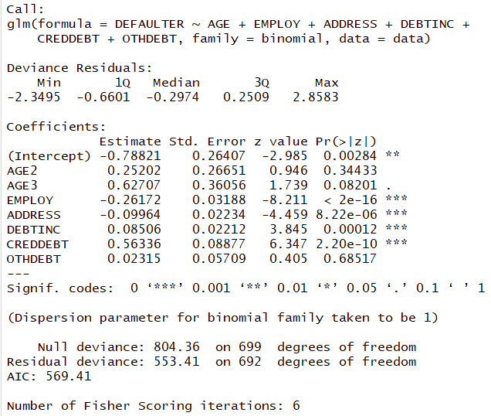
Individual Hypothesis Testing in R
# Individual Testing
summary() function gives the output of glm.
summary(riskmodel)
# Output:
Interpretation :
Since p-value is <0.05 for Employ, Address, Debtinc, Creddebt, these independent variables are statistically significant.

Slide 13
Quick Recap
CI Tree
partykit::ctree() in package “partykit” yields conditional inference trees for continuous & categorical independent variables

Slide 14
THANK YOU!!

